Slide 1
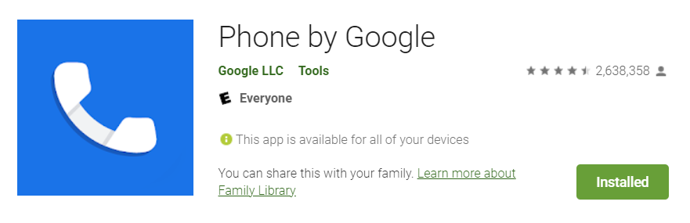
GMS Apps Investigations
Part 2: GMS Google Phone Dialer App

Slide 2
Phone Dialer App?

Slide 3
What is Phone Dialer App?
It's the default phone app on many Android devices
especially Google Pixel phones and some other OEM devices running stock or near-stock Android.
can sometimes be downloaded from the Google Play Store on compatible devices.
Key features: handles phone calls, call history, contacts
Other features: spam call filtering, visual voicemail, and call screening
Package ID: com.google.android.dialer

Slide 4
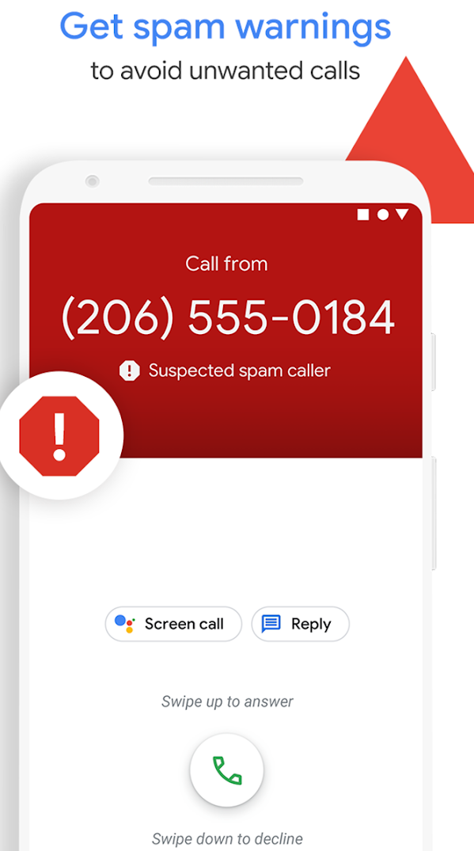
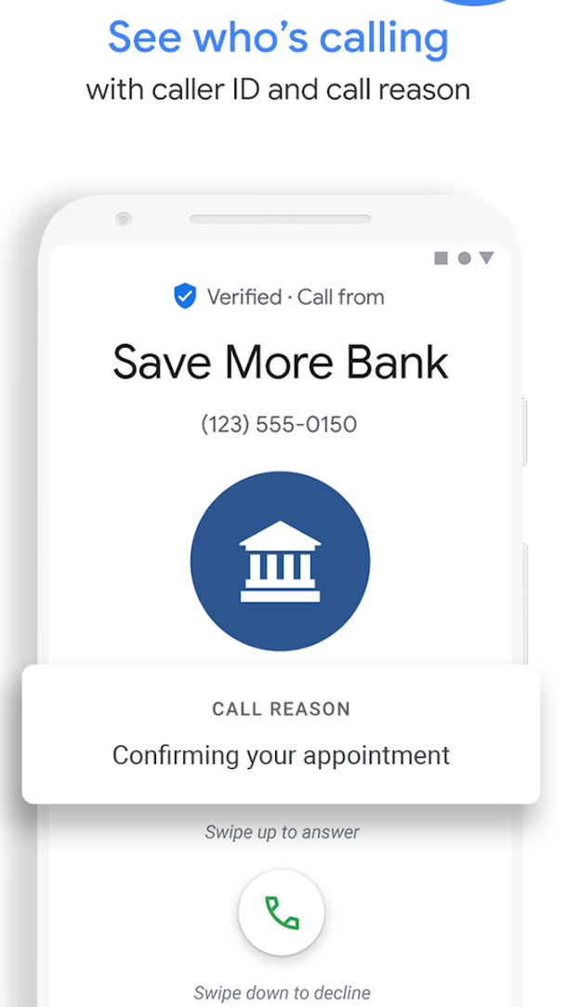
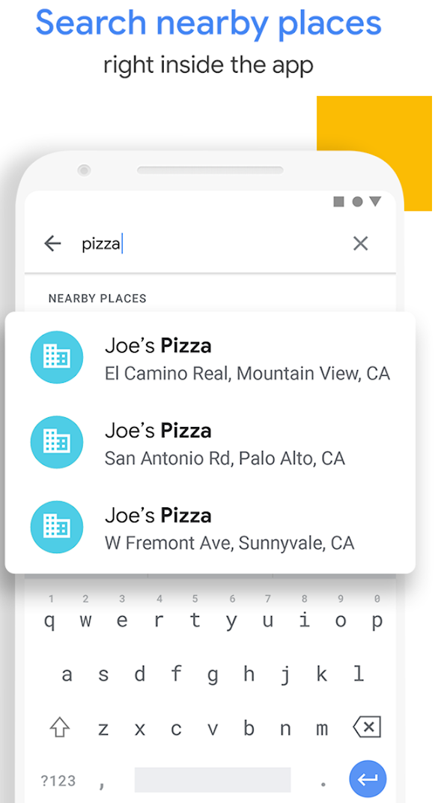
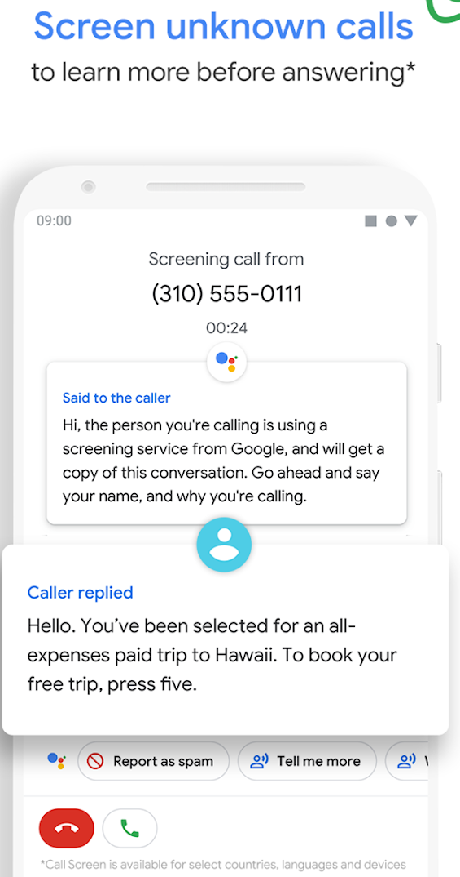

Slide 5
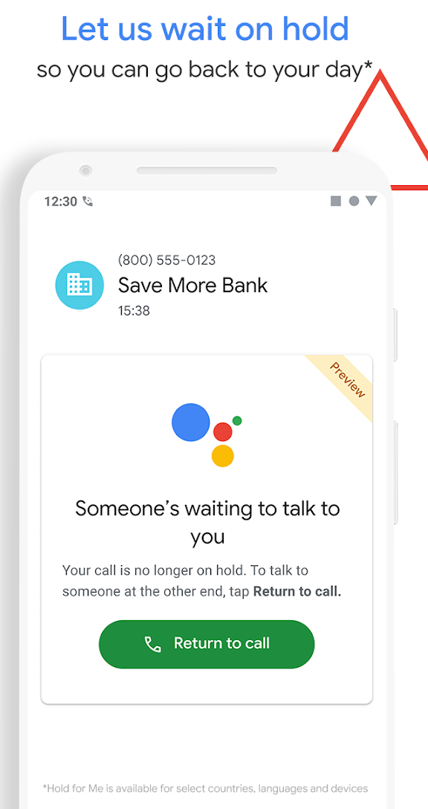
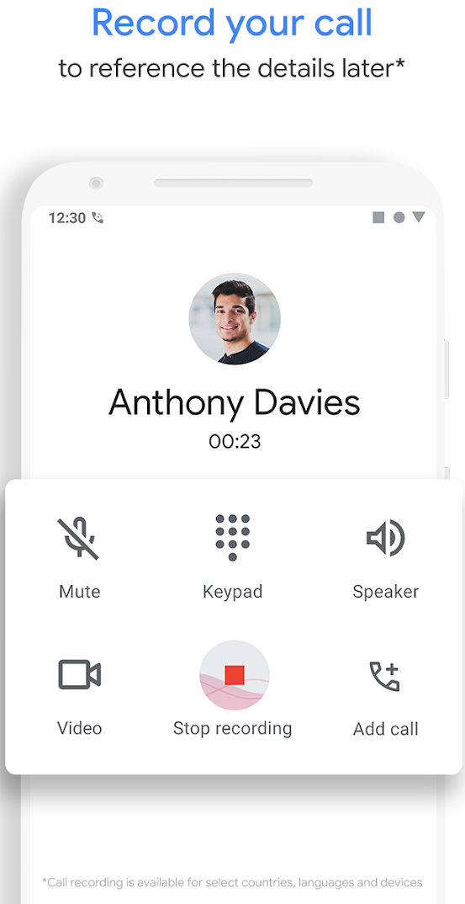
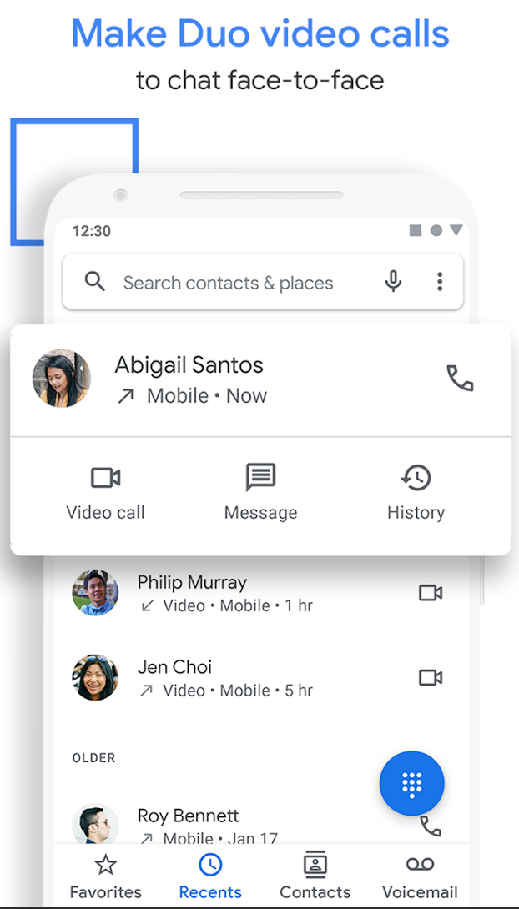
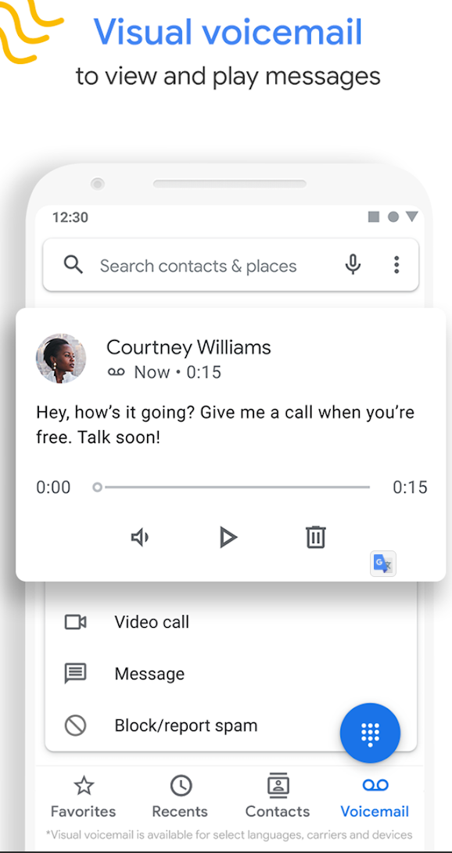

Slide 6
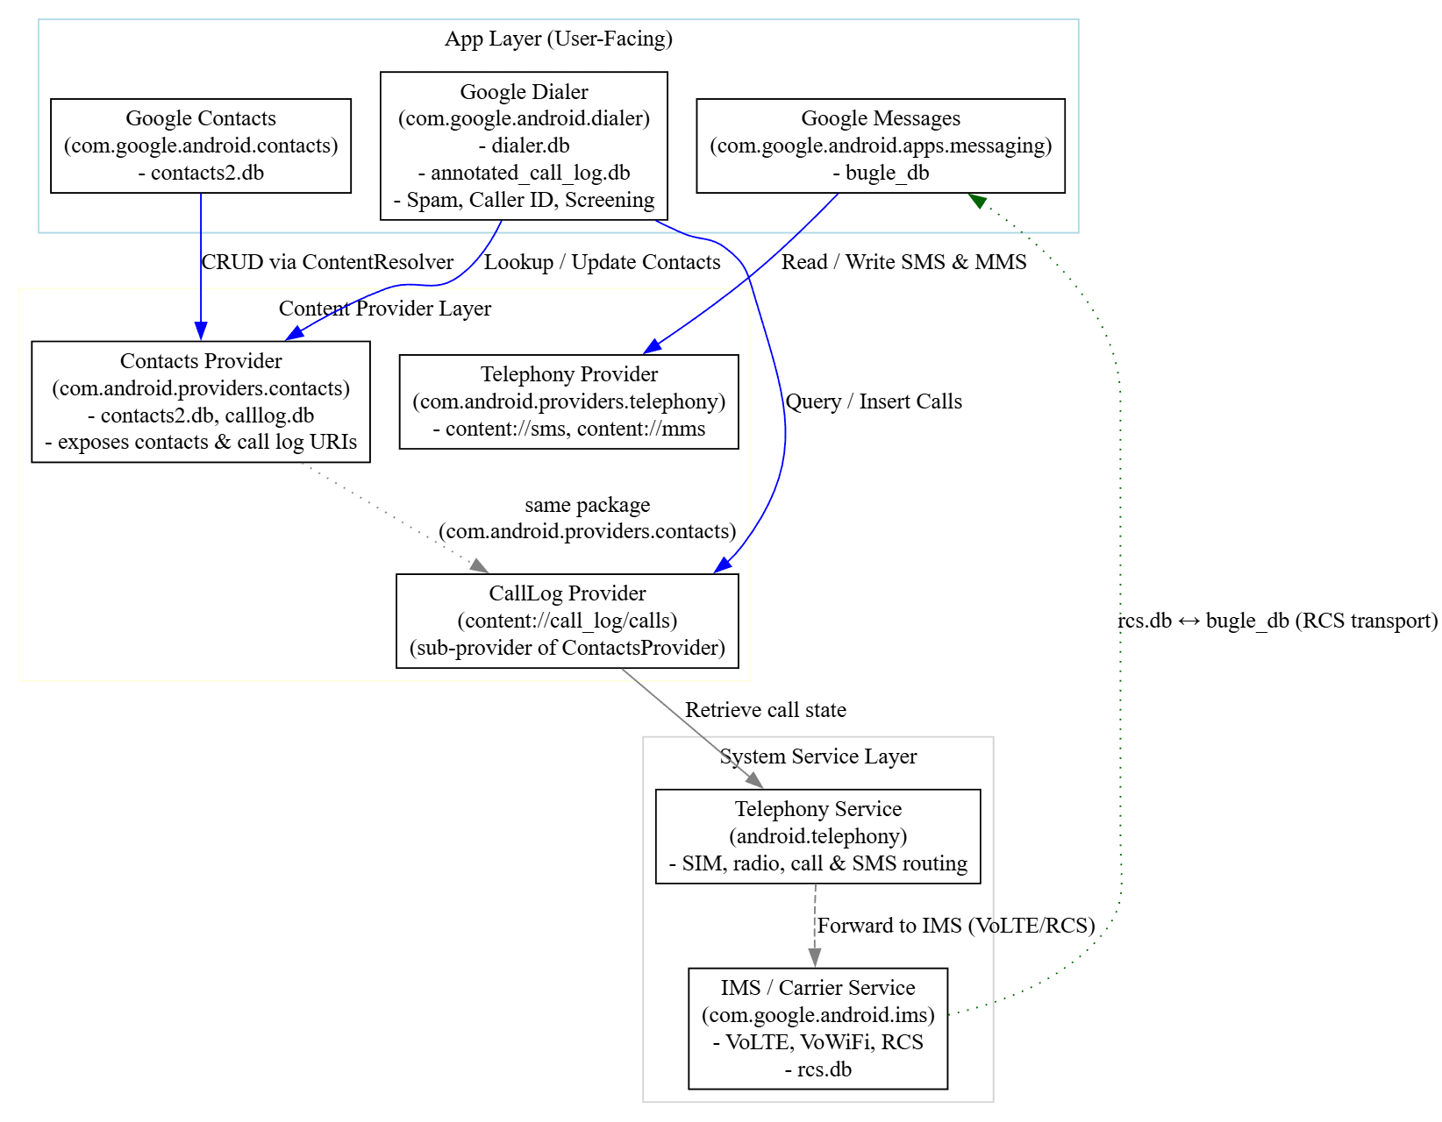
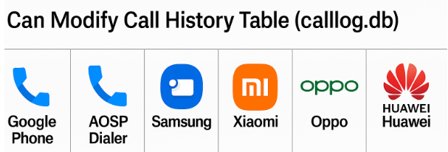

AOSP service layer
Provider | Authority | Backing Package | Notes
Contacts Provider | com.android.contacts | com.android.providers.contacts | Manages contacts, raw contacts, data rows (emails, phones, etc.)
CallLog Provider | Calllog.db | com.android.providers.contacts | Manages call history (incoming, outgoing, missed calls, etc.)
IMS Service |  | com.google.android.ims | Implements IP Multimedia Subsystem for VoLTE, VoWiFi, and RCS
Telephony Service |  | com.android.phone | Managing call & SMS/MMS
Notes:
digraph GoogleDialerArchitecture {
rankdir=TB;
node [shape=box, style=filled, fillcolor=white];
subgraph cluster_app {
label="App Layer (User-Facing)";
color=lightblue;
GoogleDialer [label="Google Dialer\n(com.google.android.dialer)\n- dialer.db\n- annotated_call_log.db\n- Spam, Caller ID, Screening"];
ContactsApp [label="Google Contacts\n(com.google.android.contacts)\n- contacts2.db"];
Messaging [label="Google Messages\n(com.google.android.apps.messaging)\n- bugle_db"];
}
subgraph cluster_provider {
label="Content Provider Layer";
color=lightyellow;
ContactsProvider [label="Contacts Provider\n(com.android.providers.contacts)\n- contacts2.db, calllog.db\n- exposes contacts & call log URIs"];
CallLogProvider [label="CallLog Provider\n(content://call_log/calls)\n(sub-provider of ContactsProvider)"];
TelephonyProvider [label="Telephony Provider\n(com.android.providers.telephony)\n- content://sms, content://mms"];
}
subgraph cluster_system {
label="System Service Layer";
color=lightgray;
TelephonyService [label="Telephony Service\n(android.telephony)\n- SIM, radio, call & SMS routing"];
IMSService [label="IMS / Carrier Service\n(com.google.android.ims)\n- VoLTE, VoWiFi, RCS\n- rcs.db"];
}
// App → Provider relationships
GoogleDialer -> CallLogProvider [label="Query / Insert Calls", color=blue];
GoogleDialer -> ContactsProvider [label="Lookup / Update Contacts", color=blue];
ContactsApp -> ContactsProvider [label="CRUD via ContentResolver", color=blue];
Messaging -> TelephonyProvider [label="Read / Write SMS & MMS", color=blue];
// Provider → System Services
CallLogProvider -> TelephonyService [label="Retrieve call state", color=gray];
TelephonyService -> IMSService [label="Forward to IMS (VoLTE/RCS)", color=gray, style=dashed];
// Provider hierarchy
ContactsProvider -> CallLogProvider [label="same package\n(com.android.providers.contacts)", style=dotted, color=gray];
// Shared RCS linkage
IMSService -> Messaging [label="rcs.db ↔ bugle_db (RCS transport)", color=darkgreen, style=dotted];
}

Slide 7
Concept | calllog.db.calls (📁 com.android.providers.contacts) | annotated_call_log.db.annotatedcalllog (📁 com.google.android.dialer)
Origin | Contacts Provider (system-level) - authoritative call log | Dialer app - synced and enriched for UI display
Link key | _id | call_id (foreign key referencing calls._id)
Data type | Raw call event (date, number, type, duration, SIM info) | Enriched record (spam flags, labels, caller categories, transcriptions)
Sync direction | Contacts Provider → Dialer (read-only copy) | Updates on app refresh or content observer triggers
Persistence | System-persistent (survives app resets) | Ephemeral (lost if Dialer app data cleared)
Extra fields | — | is_spam, label, business_name, call_screening_status, transcription

Slide 8
Sample questions
List all incoming calls
Did any callers leave voice mails?

Slide 9
Phone Dialer Databases

Slide 10
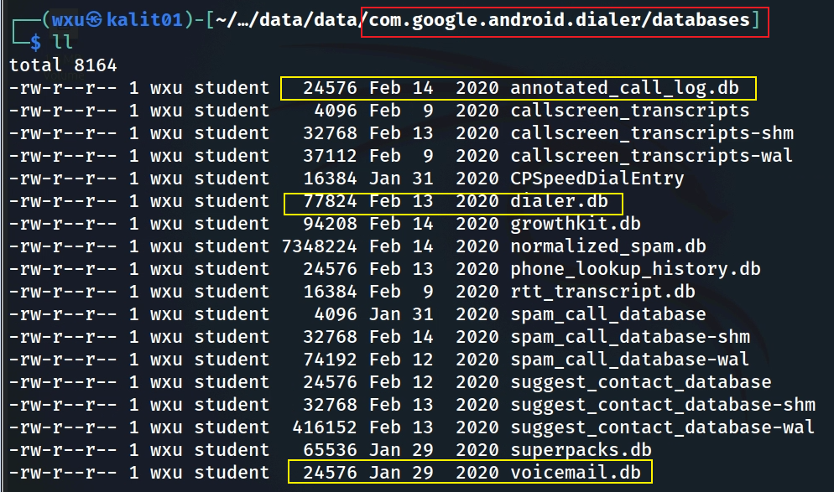
Notes:
tree 'Pixel 3/data/data/com.google.android.dialer/databases/'

Slide 11
Most Valuable Tables for Investigation (1)
annotated_call_log.db
Why? includes enriched call log data, such as whether a call was flagged as spam, marked as a favorite, or associated with a specific contact. It might also include user annotations or app-generated labels.
Use Case: Identifying suspicious calls (e.g., flagged as spam) or understanding user interactions with specific numbers.
dialer.db
Why? containing contact information, smart dial data, and filtered number data. It’s a primary source for understanding contact associations and some usage patterns but does not contain detailed call logs.
Use Case: Investigating frequently contacted numbers, mapping phone numbers to contacts, and identifying blocked or filtered numbers.

Slide 12
Most Valuable Tables for Investigation (2)
suggest_contact_database
Why? store data for suggesting contacts, likely across a broader range of interactions beyond just dialing.
Suggesting contacts to call based on recent interactions (calls, messages, emails).
Suggesting contacts for sharing content (e.g., via the share sheet).
Suggesting contacts in other contexts, like when composing a message or email.
Use Case:
Useful for understanding a broader range of the user’s interactions with contacts, not just dialing.
Could reveal contacts the user frequently interacts with across different apps or contexts (e.g., messaging, email), which might not show up in smartdial_table if they weren’t dialed.

Slide 13
Most Valuable Tables for Investigation (3)
voicemail.db
Why? Voicemails can contain critical information, such as audio recordings, transcriptions, and metadata about the caller. This could reveal important conversations or evidence.
Use Case: Extracting voicemail content for evidence of threats, plans, or other relevant communications.
phone_lookup_history.db
Why? This database tracks phone number lookups, which could reveal attempts to identify unknown callers, reverse lookups, or spam detection queries. It might also show if the user or app queried a number against a known database.
Use Case: Investigating whether the user was dealing with unknown or suspicious numbers.

Slide 14
Most Valuable Tables for Investigation (4)
rtt_transcript.db
Why? If the user used RTT (Real-Time Text) for communication, this database could contain transcripts of text-based conversations during calls, which might be relevant for accessibility users or specific investigations.
Use Case: Extracting text communications that occurred during calls.
callscreen_transcripts
Why? contains transcriptions of call screening interactions (e.g., Google’s Call Screen feature, which answers calls and transcribes responses). It could reveal interactions with unknown callers.
Use Case: Investigating interactions with unknown or suspicious callers through call screening.

Slide 15
annotated_call_log.db

Slide 16
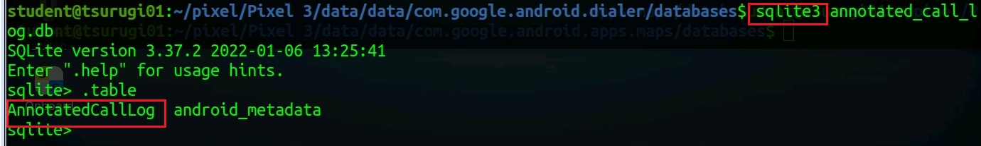

Slide 17
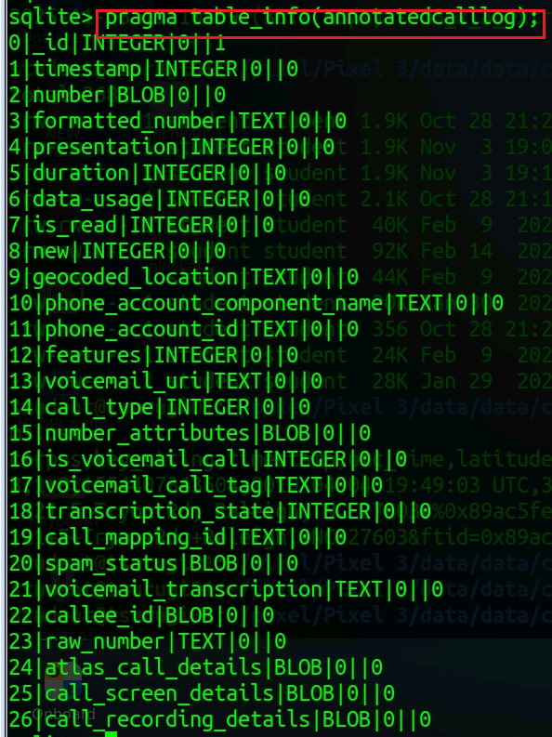

Slide 18
Column (AnnotatedCallLog) | Type | Description
_id | PRIMARY KEY | Local unique identifier for the cached call entry in this table (not necessarily equal to _id in calllog.db).
timestamp | INTEGER | UNIX epoch time (milliseconds) when the call occurred (maps to date in system call log).
number | TEXT | Raw phone number as stored from the system call log (Calls.NUMBER).
formatted_number | TEXT | Human-readable formatted version (with country code and spacing). Derived using Google’s libphonenumber.
presentation | INTEGER | How the number was presented: 1 = allowed, 2 = restricted, 3 = unknown, 4 = payphone (see CallLog.Calls.PRESENTATION_*).
duration | INTEGER | Length of call in seconds.
data_usage | INTEGER | Bytes used for data-based calls (VoIP, RCS, Duo, etc.). Often 0 for normal cellular calls.
is_read | INTEGER (0/1) | Whether the user has viewed this call entry (affects “new call” badge in the Dialer).
new | INTEGER (0/1) | Same logic as in system log – 1 if the call is new/unread, 0 otherwise.
geocoded_location | TEXT | Location string inferred from number prefix (e.g., “Maryland, USA”). Added by Dialer’s number lookup service.
phone_account_component_name | TEXT | Component name of the telephony account (e.g., SIM or VoIP package). Helps distinguish SIM1 vs SIM2 vs Wi-Fi call.
phone_account_id | TEXT | Identifier of the phone account (e.g., IMSI or account tag).
features | INTEGER | Bitmask flags for call features (e.g., video call, Wi-Fi call, RTT, etc.) matching CallLog.Calls.FEATURES_*.
voicemail_uri | TEXT | URI to the voicemail content if this was a voicemail entry (content://voicemail/…).
call_type | INTEGER | Type of call: 1=INCOMING, 2=OUTGOING, 3=MISSED, 4=VOICEMAIL, 5=REJECTED, 6=BLOCKED, 7=ANSWERED_EXTERNALLY.
number_attributes | INTEGER | Encoded attributes such as IS_BUSINESS, IS_EMERGENCY, IS_TOLL_FREE. Used for UI badges.
is_voicemail_call | INTEGER (0/1) | Flag indicating if this call is a voicemail entry.
voicemail_call_tag | TEXT | Optional tag describing voicemail call source or type.
transcription_state | INTEGER | State of voicemail transcription: 0=none, 1=pending, 2=complete, 3=failed.
call_mapping_id | INTEGER | Mapping key linking this annotated entry to the corresponding calls._id in calllog.db.
spam_status | INTEGER | Spam evaluation result: 0=not spam, 1=suspected spam, 2=confirmed spam.
voicemail_transcription | TEXT | Full text transcription of a voicemail, if available.
callee_id | TEXT | Cached display name or lookup key (e.g., contact name, business name, or Google caller ID).
raw_number | TEXT | Unformatted original dialed number before normalization.
atlas_call_details | TEXT (JSON) | Internal JSON field used for analytics and metrics (“Atlas” is Google’s internal dialer analytics module).
call_screen_details | TEXT (JSON) | JSON-encoded metadata for Google’s Call Screen feature (e.g., transcript, reason, outcome).
call_recording_details | TEXT (JSON) | Metadata for recorded calls (if supported in that region). Contains file path, duration, mime type, etc.

Slide 19
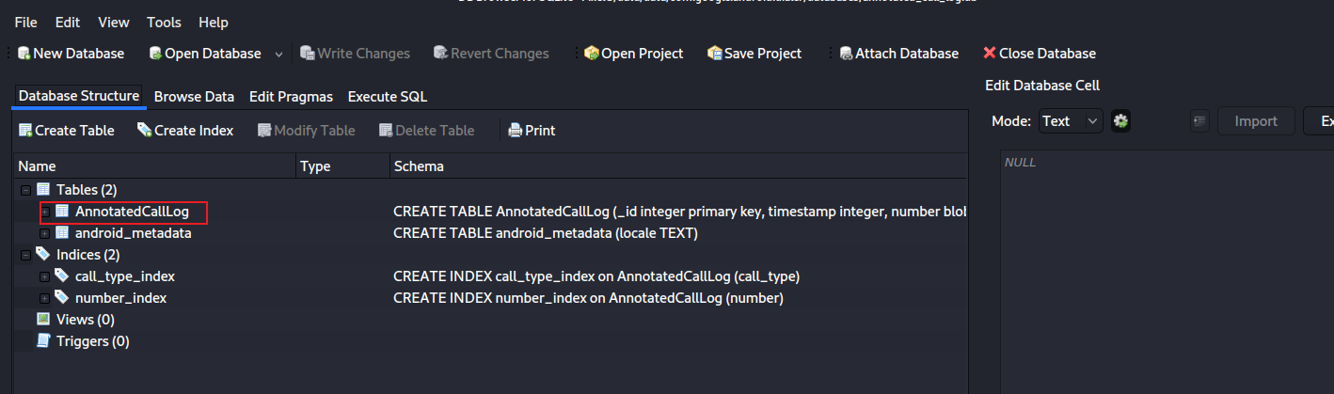
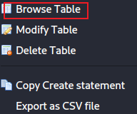
AnnotatedCallLog table content
Notes:
sqlitebrowser 'Pixel 3/data/data/com.google.android.dialer/databases/annotated_call_log.db'

Slide 20
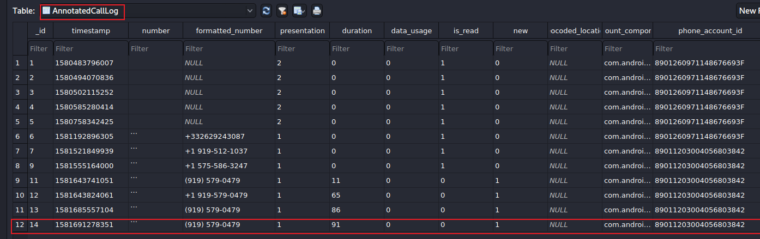
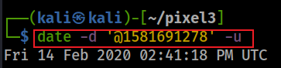
phone_account_component_name
com.android.phone/com.android.services.telephony.TelephonyConnectionService
calling/
received number
91 seconds
0: took the call
1: missed
The identifier for the account used to place or receive the call.
The phone has two accounts
calling/received time
Number is allowed to display for caller id.
1: number # showed
2: private #
The component name of the account used to place or receive the call
Notes:
date -d '@1581691278’ –u
https://developer.android.com/reference/android/provider/CallLog.Calls

Slide 21
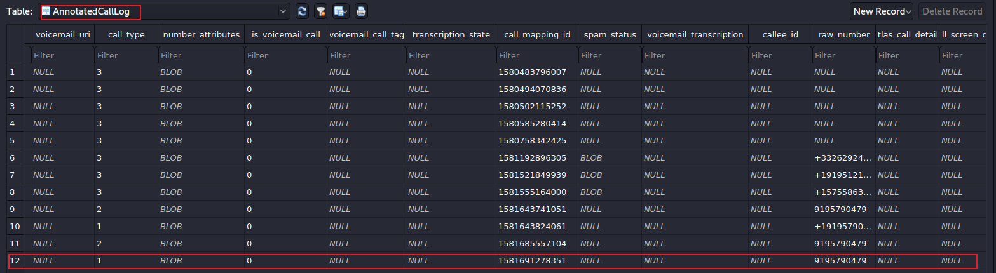
url to voicemail
1: incoming
2: outgoing
3: missed
left voice mail?
Voicemail transcription state, ie. in-progress, failed
Notes:
https://developer.android.com/reference/android/provider/CallLog.Calls.html#TYPE
https://android.googlesource.com/platform/packages/apps/Dialer/+/5d01ebb84a25c097a58ea8a3e1b4a521456e6f17/java/com/android/dialer/calllogutils/PhoneCallDetails.java

Slide 22
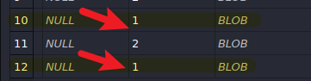
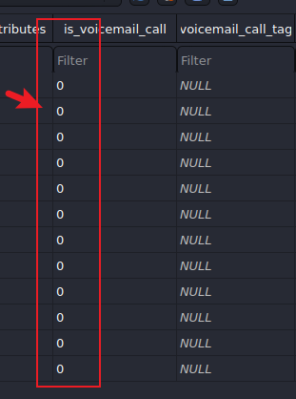
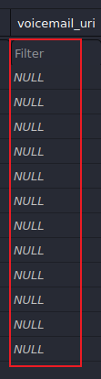
Sample Questions
List all incoming calls
2
Did any callers leave voice mails?
none

Slide 23
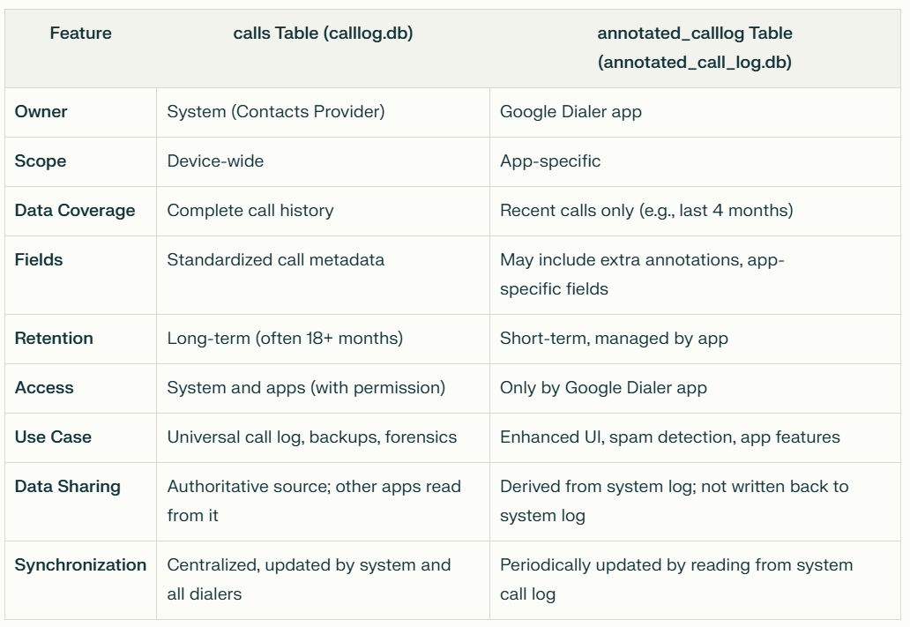

Slide 24
Data sharing between calllog.db and annotated_call_log.db
Data Sharing:
The calls table is the authoritative source. The Google Dialer and other apps read from it, but do not write data from their own databases back to it.
The annotated_calllog table is a copy/subset of recent entries from the system call log, enhanced with app-specific annotations.
Synchronization:
There is no automatic, two-way synchronization between the two databases.
The Google Dialer app periodically reads new entries from the system call log and updates its own annotated_calllog table as needed.
No foreign key in either table that references the other table’s primary key.
The annotated_calllog table is populated by the Google Dialer app reading data from the system calls table and copying relevant fields, but this is done at the application logic level, not via database-enforced foreign key constraints.

Slide 25
Question
Can we recover a call log if you delete a call in Google Dialer?
Answer
Immediately after deletion, recovery from calllog.db’s unallocated pages or WAL is often possible.
After a few minutes or reboot, Android’s periodic VACUUM or WAL checkpoints likely overwrite those deleted pages.
Question | Answer
Does deleting a call in Google Dialer remove it from calllog.db? | Yes — deletion propagates through ContentResolver to the calls table in calllog.db.
Can it be recovered later? | Possibly, if the database hasn’t been vacuumed or checkpointed; deleted rows can remain in unallocated or WAL space.
Where to focus in forensics? | /data/data/com.android.providers.contacts/databases/calllog.db and its -wal file. Ignore dialer.db unless analyzing spam/screening metadata.

Slide 26
dialer.db

Slide 27
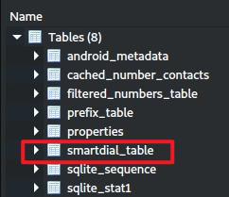
smart_dial_table
"smart dial" functionality
allows users to quickly find contacts by typing a portion of a name or number, with the app suggesting matches as they type.
Provides detailed information about frequently dialed or interacted-with contacts
including usage patterns (last_time_used, times_used).
contact_id and lookup_key can link to the Android Contacts database,
starred or is_primary can indicate important contacts.

Slide 28
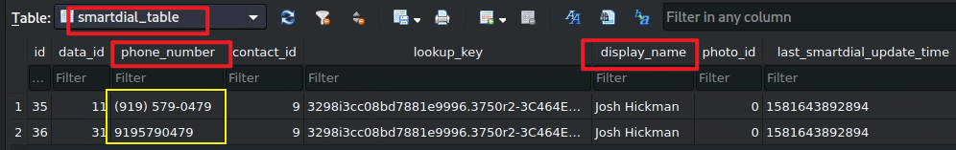
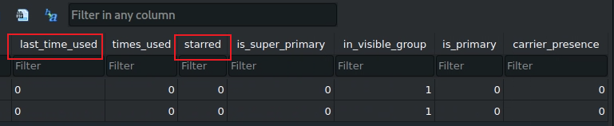
Two phone numbers are found

Slide 29
suggest_contact_database

Slide 30
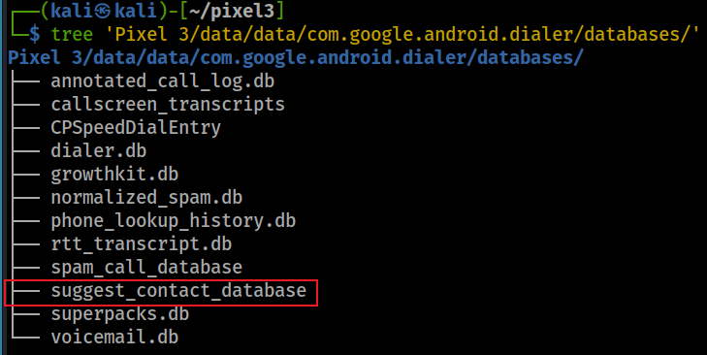
Understand user’s interactions with contacts, not just dialing
When you try and share photos or anything from Google pixel, you will see suggested contacts pops up with several frequently contacted people in the phone

Slide 31
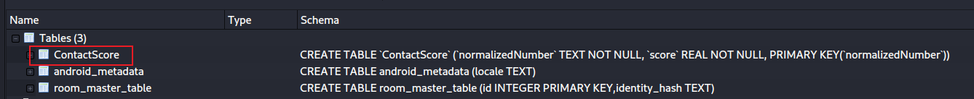
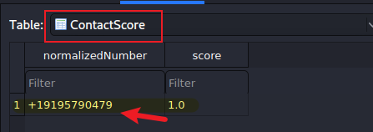
Open suggest_contact_database
Find thefrequently contacted phone numbers
Field | Type | Description
normalizedNumber | TEXT | The phone number in normalized E.164 format (for example +13015551234). Acts as the primary key.
score | REAL (float) | A computed weight representing how “important” or “frequently used” the number is to the user.

Slide 32
score in ContactScore table
normalizedNumber | score
+13015551234 | 0.94
+12405550000 | 0.78
+18005550123 | 0.45
How is a score calculated?
When a call is made, answered, or missed, the Dialer updates or increments the score.
When a number stops being used, its score decays over time.
The values are stored locally and not synced to Google servers.
Forensic/analytical value
It indicates communication frequency and recency — essentially a behavioral fingerprint of whom the user talks to most often.
Useful in digital forensics to reconstruct contact importance or priority even if the call logs were deleted.
Since it’s stored separately, a deleted call may still leave a residual trace in ContactScore showing the number and its cumulative score.

Slide 33
phone_lookup_history.db

Slide 34
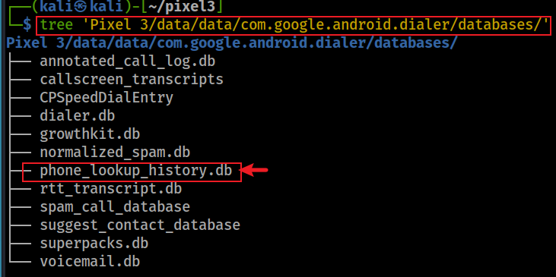
What is the phone lookup function?
Identify the caller (caller ID)
It needs to query Google’s servers or another external database
Cached these results locally in phone_lookup_history.db
Allows the app to quickly retrieve the same information if the same number calls again
Reducing the need for repeated server queries and improving performance.

Slide 35
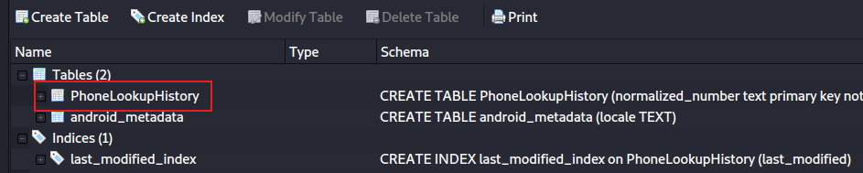
Open phone_lookup_history.db

Slide 36
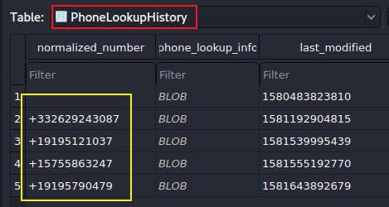
PhoneLookupHistory table
normalized_number: stores the phone number in a standardized (normalized) format
phone_lookup_info: stores the lookup information associated with the phone number.
Stored as a Binary Large Object (BLOB)
Structured data in a format like Protocol Buffers, JSON, or a custom binary format, which is then deserialized by the application.
The actual content could include:
Caller details (e.g., name, carrier, location).
Metadata about the lookup (e.g., source of the data, confidence score).

Slide 37
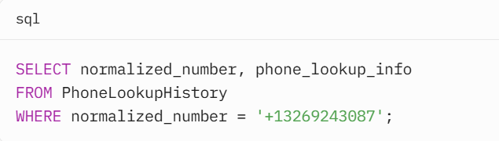
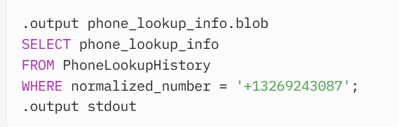
Access the BLOB
Notes:
import sqlite3
# Connect to the database
conn = sqlite3.connect('phone_lookup_history.db')
cursor = conn.cursor()
# Query the BLOB data
cursor.execute("SELECT normalized_number, phone_lookup_info FROM PhoneLookupHistory WHERE normalized_number = '+13269243087'")
row = cursor.fetchone()
if row:
normalized_number, blob_data = row
print(f"Phone Number: {normalized_number}")
# Save the BLOB to a file for further processing
with open('phone_lookup_info.blob', 'wb') as f:
f.write(blob_data)
# Close the connection
conn.close()

Slide 38
voicemail.db

Slide 39
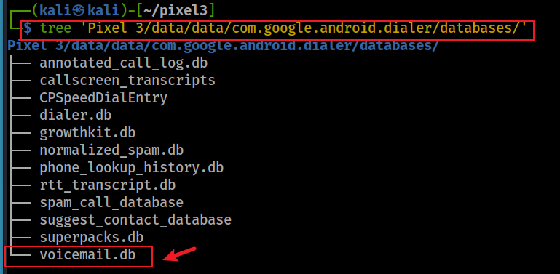
What is the greeting message?
The owner often provides greeting message. Did the owner use a greeting message?

Slide 40
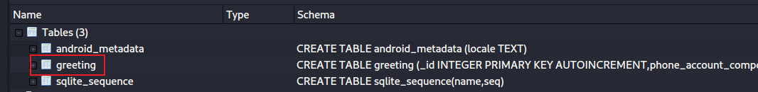
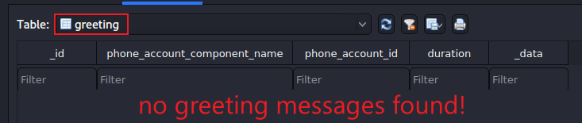
Open voicemail.db
Find thefrequently contacted phone numbers

Slide 41
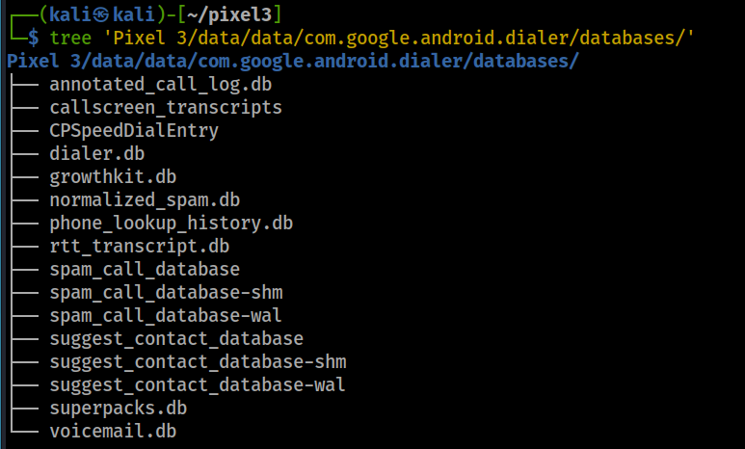
Other valuable information in databases
speed dial entry
spam call database

